Slide 1

Home credit Default risk
CSCI-P 556: Applied Machine Learning Final Project – Phase 3 Group 32
A Project By:
- Carter Holmes | cartholm - Harsh Srivastava | hsrivas - Ritwik Budhiraja | rbudhira - Yash Shah | yashah

Slide 2
OUTLINE
1. Team & Project Meta Information
2. Project Abstract
3. Project Description
3.1 Tasks that need to be tackled.
3.2 How does our data look like?
4. Exploratory Data Analysis & Feature Engineering
5. Visual Exploratory Data Analysis
6. Hyperparameter Tuning
7. Modelling Pipelines
8. Results and Discussion
8.1 Phase 1 Results & Discussion
8.2 Phase 2 Results & Discussion
8.3 Phase 3 Results & Discussion
9. Conclusion
10. Acknowledgements

Slide 3

TEAM & PROJECT META INFORMATION
Yash Shah
@yashah
Our Team
We are a group of enthusiastic Data Scientists, trying to lay our hands on every possible opportunity to work on Machine Learning Projects. We aim to make use of all that we have learnt during the course of this class and produce fruitful outcomes
Ritwik Budhiraja
@rbudhira
Harsh Srivastava hsrivas
Carter Holmes @cartholm

Slide 4
PROJECT ABSTRACT
Many people have a tough time getting loans because their credit histories are poor or non-existent. Untrustworthy lenders, unfortunately, may often take advantage of this demographic. Home Credit strives to enhance financial inclusion for the unbanked by promoting an enjoyable and secure borrowing experience. To guarantee that this underserved group has a positive loan experience, Home Credit employs a variety of alternative data, such as the person's background information, and machine learning algorithms to anticipate their clients' repayment potential. The goal of this project is to create an effective classification system for determining a client's financial ability to pay their debts. We have selected this data source as our final project for the course. To find the best solution, we will investigate a variety of machine learning methods, from traditional machine learning to deep learning, feature engineering, and hyperparameter searches; while using what we have learnt during the course – put to its best use. In Phase 1, we built a very basic model with two algorithms, logistic regression and random forest. In Phase 2, we find that the hyperparameter searches and feature engineering help us find a better model with an increased accuracy score. In Phase 3, we finish our final goal of building a model with an Artificial Neural Network. Through the last two phases we have tackled the problems like data processing issues and memory issues, that we have tackled by performing various data transformations and saving data into temporary files. As the final result of our Phase 3, we found out that the neural network we built gives an accuracy score of around 91.8% which we have selected for our final Kaggle submission. In this submission we got a score of 0.722 (public) and 0.709 (private).
(Keywords: Machine Learning, Risk Analysis, Exploratory Data Analysis, loan, testing/training data, pipeline, algorithms)

Slide 5
PROJECT DESCRIPTION & TASKS TACKLED (Phase 3)
In this phase of the project, we primarily focused on building an Artificial Neural Network for attaining better accuracies on our training model. This was the main task that has been tackled in this phase. To find a model that was best suited for us, we had to work on various permutations and combinations of the number of layers, number of perceptrons, and the number of features which posed as a problem that we faced while building the ANN. We tried to implement five different models for the same (out of which three are not present in the code log), and decided to proceed with 18 features. We shall discuss the results of this model in the further sections.
…

Slide 6
Tasks tackled in the previous phases.
Summarizing the Data: We need to understand the values present in the rows and columns of our dataset and ensure that the data is complete.
Manipulating the Data: Analyzing our data, adding numerical labels to categorical data, and noticing fallacies in the data that can cause setbacks while working ahead in this project.
Missing Data: For the columns having ‘null’ values, we are dropping columns in which the number of non-null values is lesser than the threshold set.
Exploratory Data Analysis: Exploring our data and creating visuals such as graphs, charts, and bars to read the data in a much easier format.
Baseline Pipeline: Building a machine learning pipeline with a standardizer to standardize the extracted features, using grid-search to choose the best algorithm and parameters, computing the accuracy using a suitable evaluation metric.

Slide 7
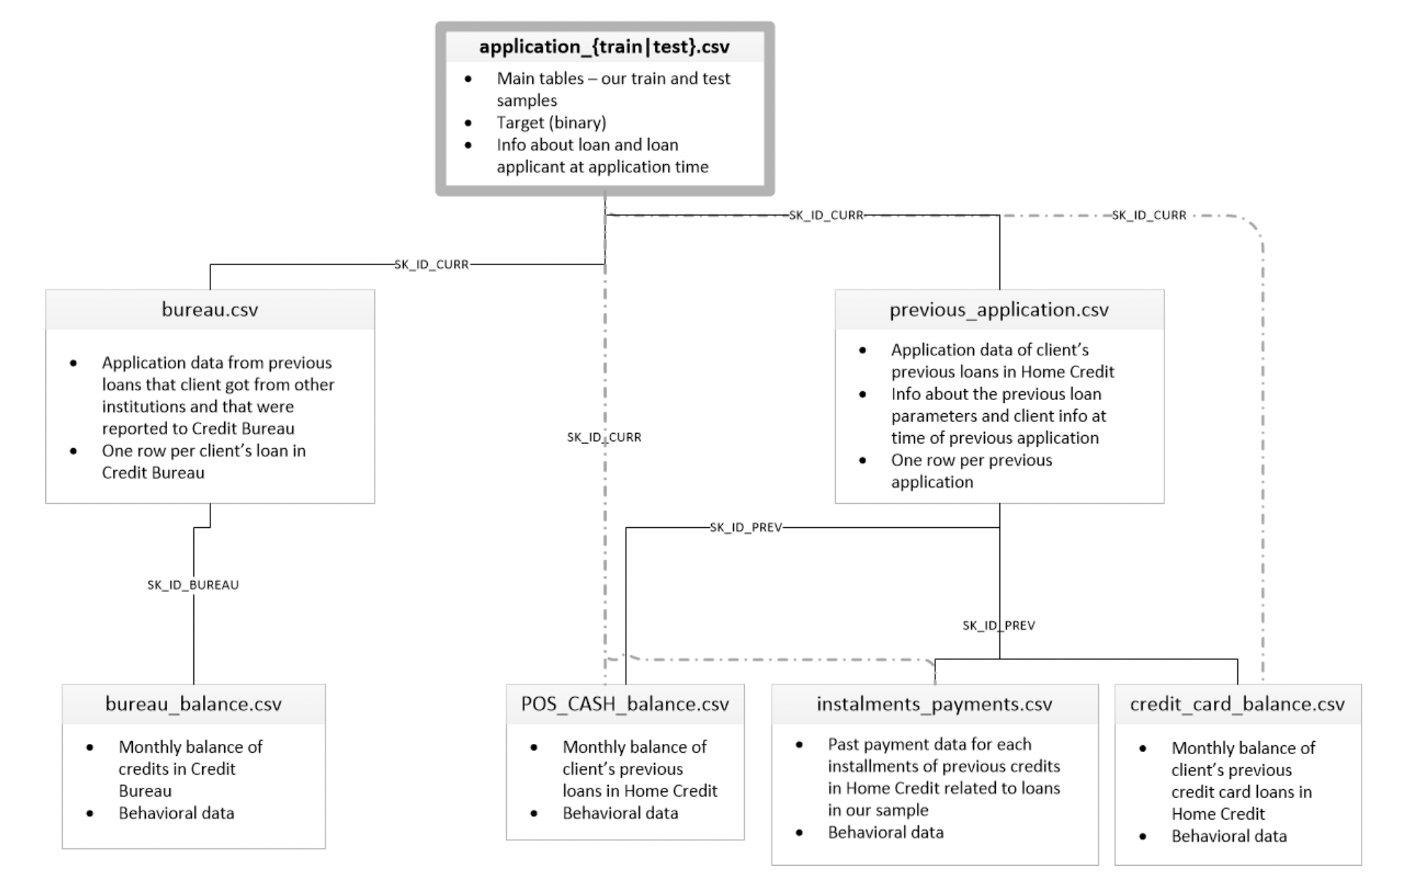
How does our data look like?
The HCDR data source consists of a cluster of nine ‘.csv’ files, as highlighted in the below image. Additionally, we have a large chunk of the remaining files that provide us with data about financial records of the applicants. To help with the labelling of data columns, there is also a column description ‘HomeCredit_columns_description.csv’ file present in the data source. Here’s a link to the dataset:
https://www.kaggle.com/c/home-credit-default-risk/data
Figure 1. Database Schema
…

Slide 8
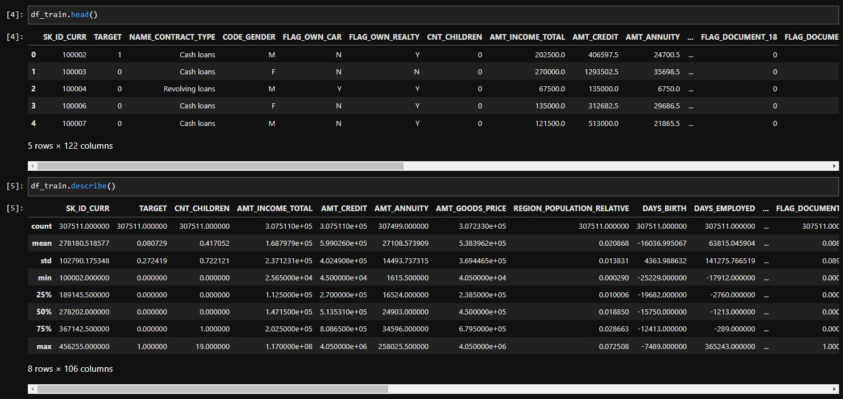
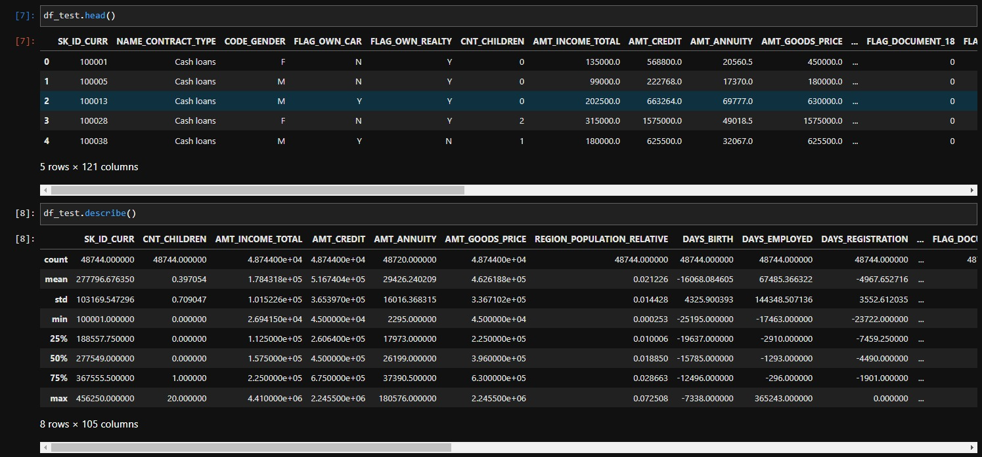
pandas is a fast, powerful, flexible, and easy to use open source data analysis and manipulation tool, built on top of the Python programming language. Here shown are a couple of ways in which we can make use of the pandas library.
The head() method in pandas is used to return the first ‘n’ rows of our dataset. It shows us the first five rows of our data when the value of ’n’ is unspecified. It is useful for quickly checking if your object has the right type of data in it
The describe() method in pandas computes and displays the summary statistics for a Python dataframe. Using this method, we can glance over our data in a very sophisticated format.
Similarly, the info() method tells us about the number of rows, columns and data types present in our dataset.
Figure 2. Description of Training Data
Figure 3. Description of Testing Data

Slide 9
EXPLORATORY DATA ANALYSIS & FEATURE ENGINEERING
We dropped rows in the training dataset which did not have any occurrences in the testing dataset so that our model becomes specific to the testing dataset provided to us.
We dealt with zero-values columns by setting a threshold value and if the column had more ‘zeroes’ than the allowed threshold, we dropped that column.
Next, we dropped the columns having NaN values with the same logic as above. The dropna() method has a “thresh’ parameter where you set the minimum number of non-NaN values and only columns equaling to that threshold value will be saved while the rest will be dropped. To find the threshold value, we used
Threshold values = Total length of dataframe – (maximum count of NaN values in a column/2)
Using interpolation to fill the missing values in the columns that were saved but still had NaN values in them.
Used get_dummies() function to implement OHE on the columns having categorical data.

Slide 10
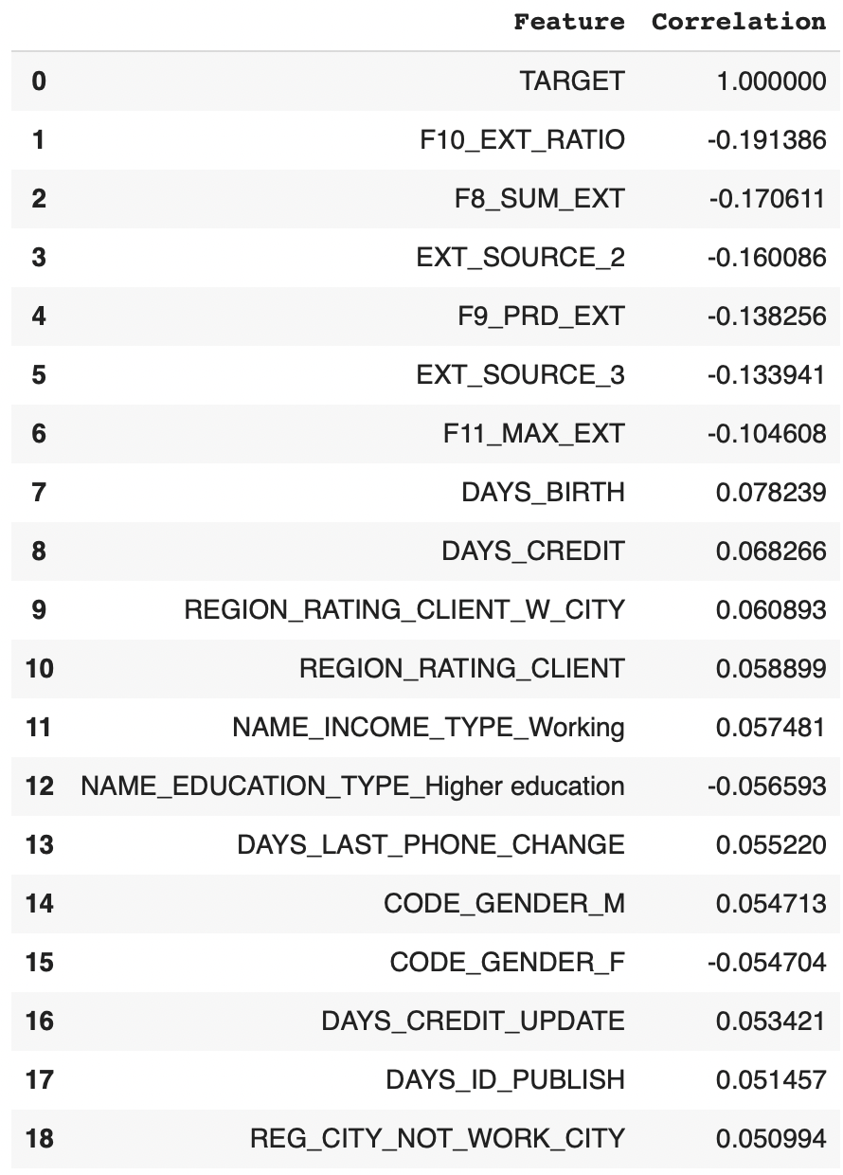
6. By determining their association with the objective variable, we were able to identify the key elements for this home credit risk prediction. As an update to phase 1 feature engineering, we took the following steps:
7. We consolidated the bureau balance, bureau, instalments payments, POS CASH balance, and previous application files into the main application train and application test files.
8. We experimented with the added features to produce new features after merging these files with the application train file.
New Features created with the highest correlation.

Slide 11
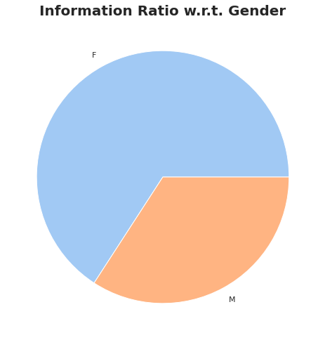
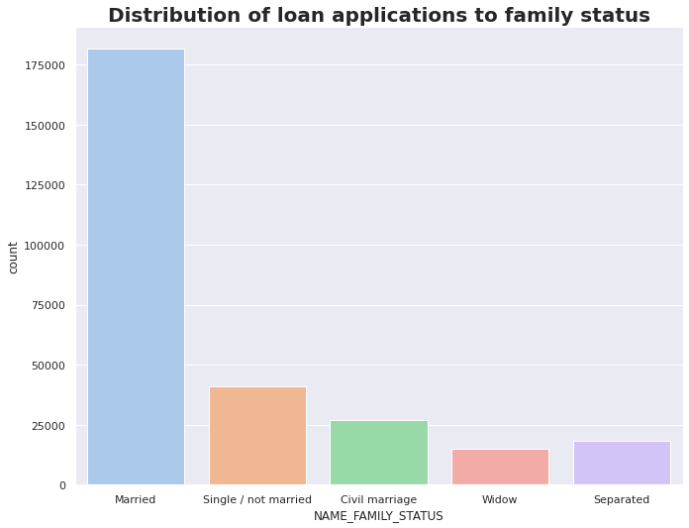
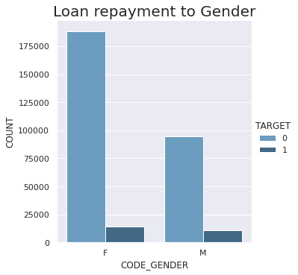
VISUAL EXPLORATORY DATA ANALYSIS
Inference
The number of females repaying the loan is higher than the number of males.
Inference
The majority of clients who are married have repaid the loan.
Inference
The number of females applying for a loan is much higher than that of men according to the pie chart above.

Slide 12
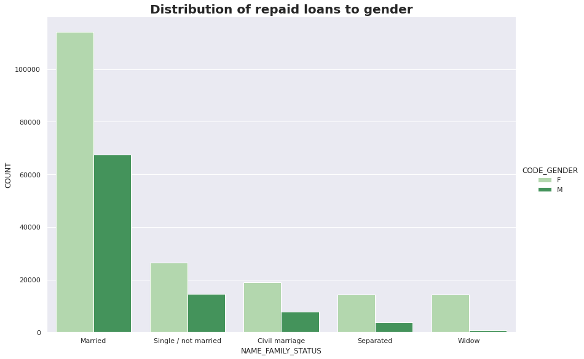
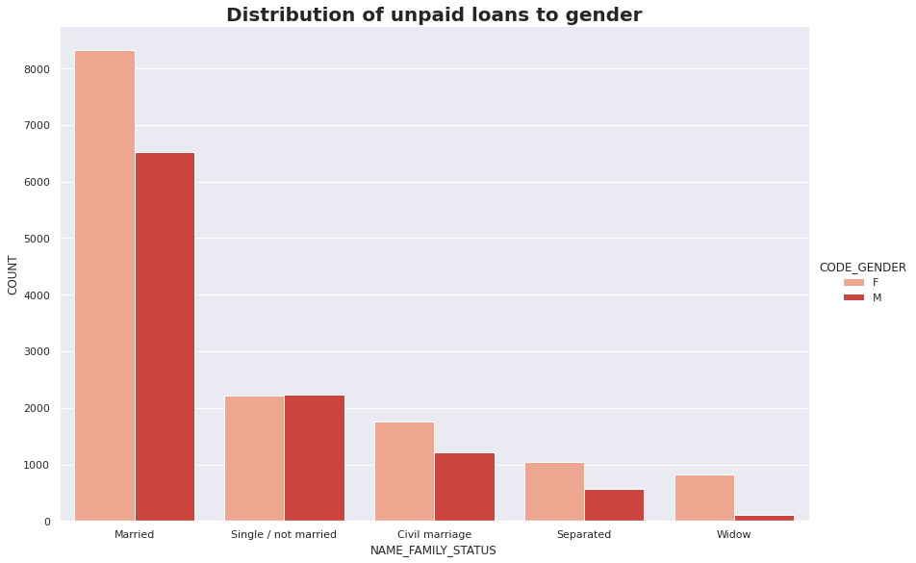
Inference
Under each family status, the females have the highest repayment percentage.
Inference
The number of females applying for a loan is much higher than that of men according to the pie chart above.

Slide 13
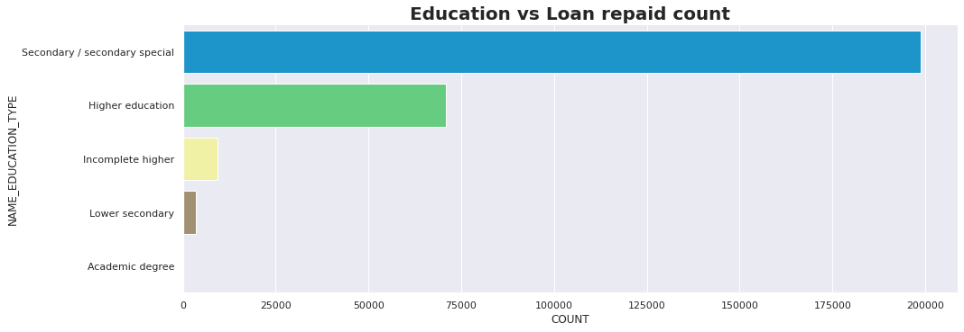
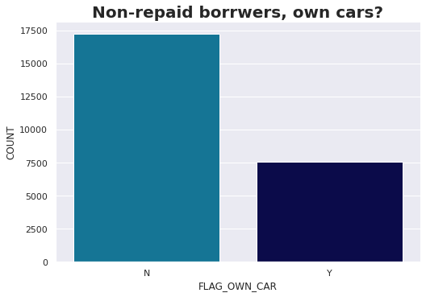
Inference
Clients with a secondary/special degree, are more likely to repay the loans compared to the others..
Inference
Out of 25000 people who have not repaid the loan, 70% of people do not own a car!

Slide 14
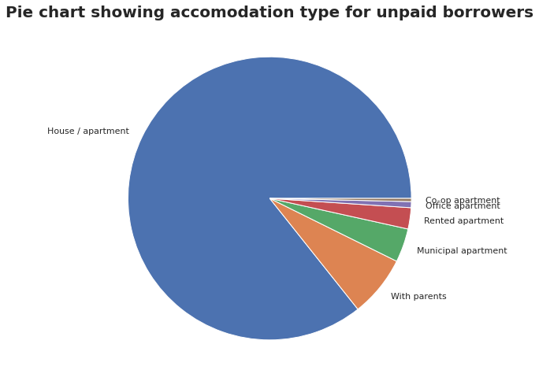
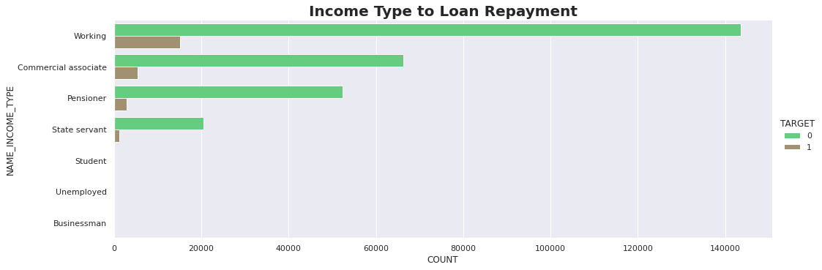
Inference
Although the loans are not repaid, maximum number of people still live in their own houses/apartments.
Inference
According to the visualization on the right. Clients with a working income type have repaid most loans.

Slide 15
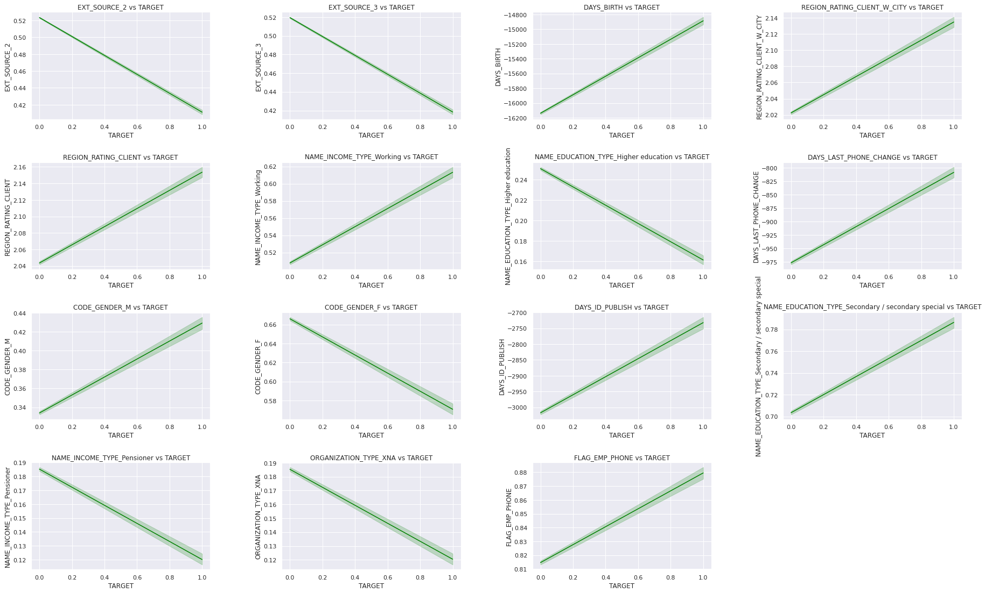
Inference
In this visualization, we are trying to see if the variables possess a linear relationship with the target variables or not. This is only so that we can ensure the use of a linear model like a Logistic Regression Model. All these variables show a linear relationship be positive or negative.

Slide 16
HYPERPARAMETER TUNING
After selecting the optimal features for our models, we use hyperparameter tuning to find the most optimal setting for running our model.
For hyperparameter tuning, we have decided to use GridSearchCV. The GridSearchCV is a library of sklearn’s model selection package. It helps to fit our model to our data by using the best running conditions and the best parameters possible.
By just specifying the model, input parameters, and accuracy we want, we can easily obtain the best running conditions and features using GridSearchCV.
In our code, for logistic regression, we have created a function for GridSearchCV with 3 cross-validations for the hyperparameters and 1000 max iterations.

Slide 17
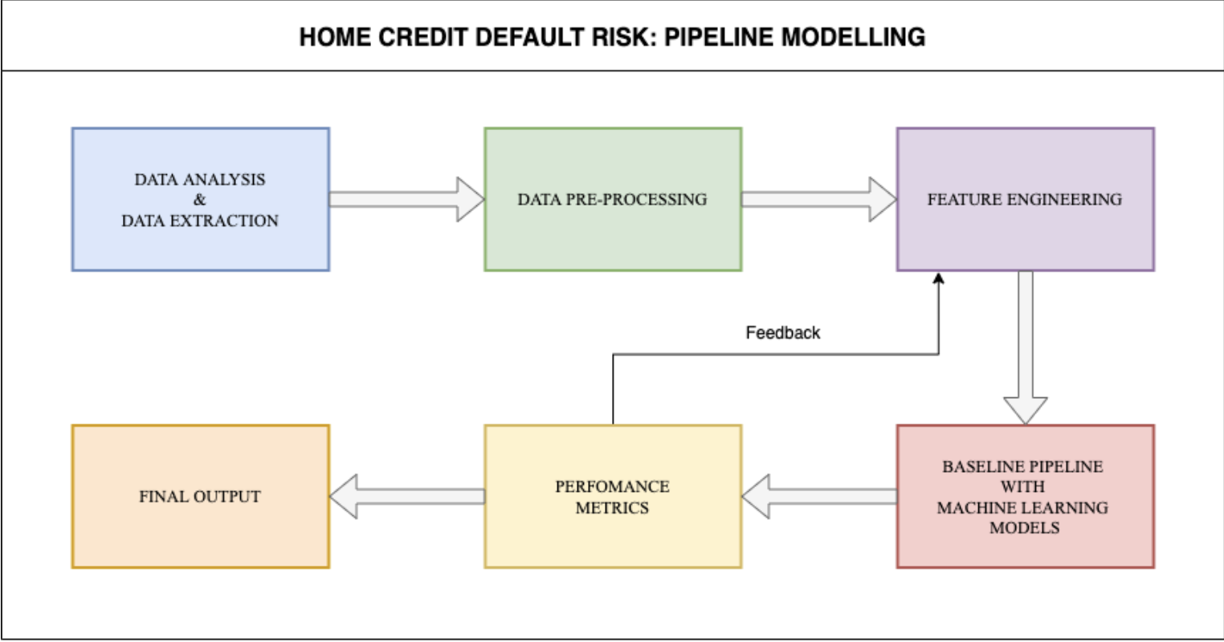
MODELLING PIPELINES
For this project, we created a basic pipeline for numerical data.
Next, we create a column transform pipeline and run a transform. Then we make the transformed data into a data frame.
We have made use of three models which are Logistic Regression, Naïve Bayes (Gaussian), and Random Forest Model
Let’s have a look at the results and discuss the findings.
Initial Pipeline Modelling

Slide 18
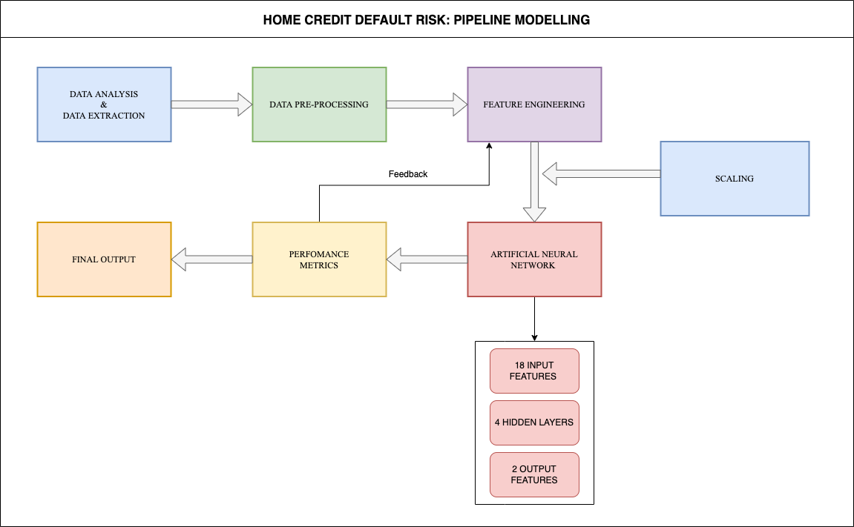
As shown in the diagram alongside, we introduced Scaling after creating new features and passing them onto the Machine Learning Model. The final pipeline contained an Artificial Neural Network as the final model. For the ANN, we had one input with 18 features, 4 hidden layers with 50, 80, 32, and 10 perceptrons in the hidden layers, and 2 output features.
Final Pipeline Modelling

Slide 19
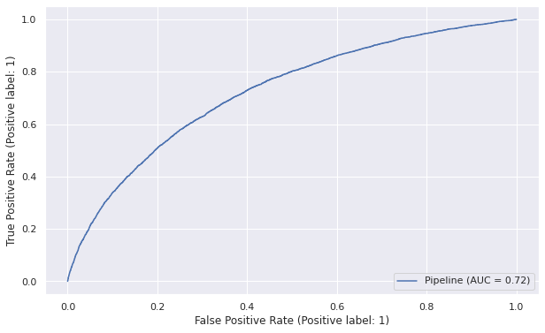

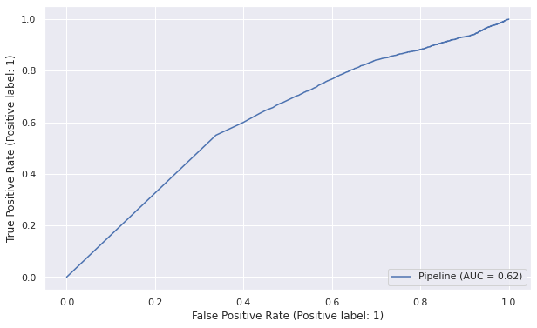
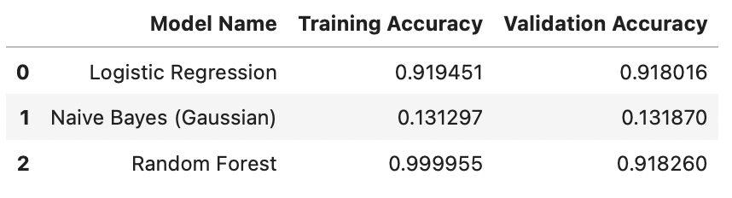
RESULTS: Phase 1
Logistic Regression
Random Forest
Naïve Bayes (Gaussian)

Slide 20
DISCUSSION: Phase 1
From the above three pipeline tests we can see that the highest accuracy is obatined by using the Random Forest model, with accuracy of 91.826%. We also get the Logistic Regression model with accuracy of 91.802%. Both these models seem to be good models to start with.
The ROC value for Logistic Regression and Random Forest is 0.72 and 0.71 which show a significant amount of True Positive values and indicate a good fit. The Naive Bayes is however not so great with only 0.62, so we cannot move forward with Naive Bayes on this ground as well.
We need to check if Logistic Regression or Random Forest is a better model and whether either of them are overfitting.

Slide 21
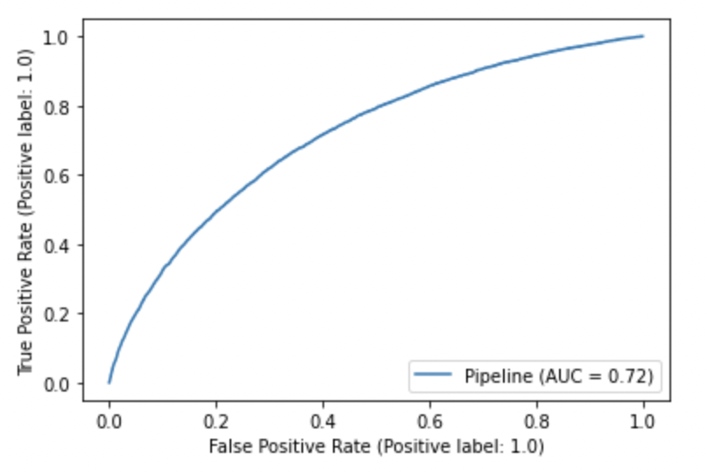
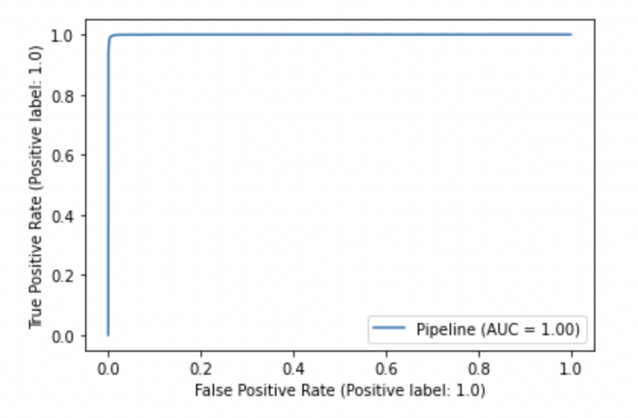
RESULTS: Phase 2
Logistic Regression
Random Forest

Slide 22
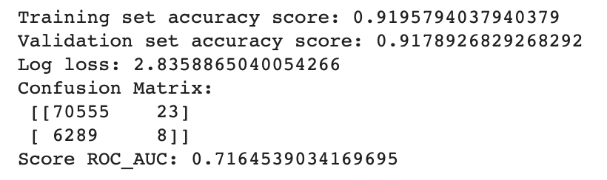
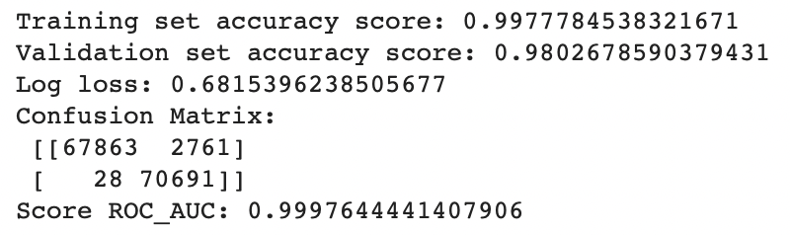
DISCUSSION: Phase 2
In this Phase, we achieved a better score from our Phase 1 model using Random Forest Classifier on Kaggle
We found that the Random Forest model still yielded better results than the Logistic Regression model.
The ROC for Logistic Regression Model is 0.72 and that for the Random Forest model is nearly 0.99
We also discovered that the creation of new features created highly correlated columns that improved our model’s accuracy.
Logistic Regression
Random Forest

Slide 23
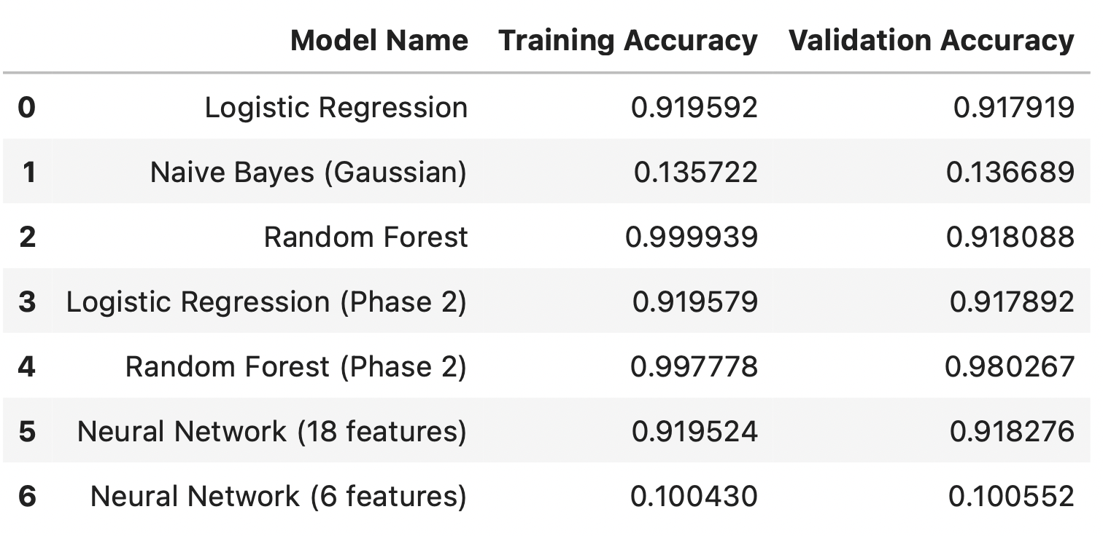
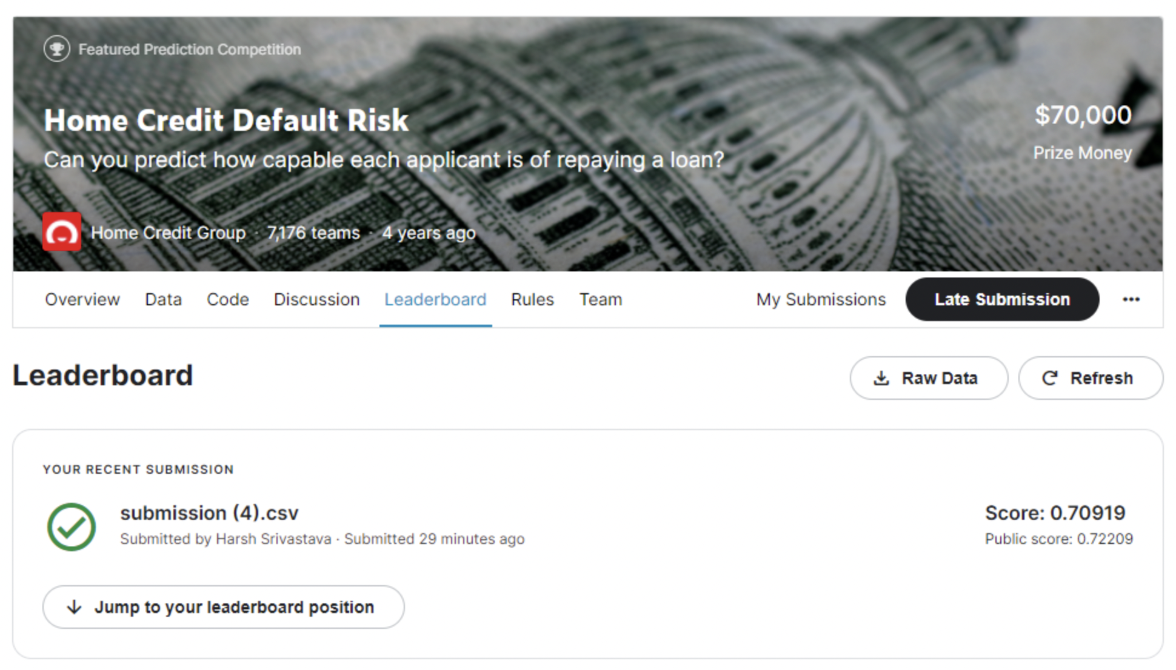
RESULTS: Phase 3

Slide 24
DISCUSSION: Phase 3
We have tried two models each with different layers of perceptrons and with different feature counts. Upon validating both models we see that the first model gives a better validation accuracy (0.918), and the second model (with 6 features), doesn't give a good accuracy.
Our inference is that the first model is the best fit and is not overfitting because we also tried it with lesser columns, but it gives us the best accuracy at the 18 columns from Phase 2. Now second model is definitely under-fitting because of the accuracy.
Therefore, we will proceed with the Neural Network model to get the Kaggle score. In this submission we got a score of 0.722 (public) and 0.709 (private).
Based on our results, we can see that the accuracy of logistic regression and Neural Network (18 features) is very close (~0.919). Based on this we can conclude both models to be a good choice. However, when tested with the validation set we get a slightly higher accuracy with the Neural Network.

Slide 25
CONCLUSION
In conclusion, we started experimenting with the different data columns, and selected most correlated columns to TARGET. After this we converted object typed / categorical types to numerical values by expanding our columns with multiple columns encoded in one-hot encoding for a certain class label corresponding to each unique value. After this we interpolated this data to fill any 'nan' values that might be remaining. It was after this stage that we were able to form any meaningful conclusions. We also made graphs/charts/plots to understand different relations in the columns that we had filtered out of the initial 122 columns. At the end we ended up with 127 unique columns (after categorical to numerical conversion). Using this encoded data we tested three models, 1. Logistic Regression, 2. Naive Bayes, 3. Random Forest models and found that both 1 and 3 gave the best accuracy. The ROC for 1 and 3 were also very similar but ROC for 2 it was quite low and so we finally rejected model 2. Moving ahead we tested the accuracy on the testing dataset with model 1 and 3. Model 3 had higher accuracy so we decided to submit this one to Kaggle. In Phase 2, we tackled the problem of high number of columns, but also introduced new columns for getting highly correlated features. Using machine learning we can predict the target values based on these newly engineered features. We ended up with a high accuracy on Random Forest classifier in the transformed-merged test data augmented with the different datasets provided. In Phase-3 we tried and tested different Neural Network models with different columns, but at the end we realised that the 18 column model was the best fit among others. This is the final model we've submitted to the final Kaggle submission and obtained a public score of 0.722. For future scope of our project, we need more visualization functions to draw out more insights and implement more bagging and boosting methods to possibly get a better result.

Slide 26
ACKNOWLEDGEMENTS
We would like to express our gratitude to Dr. James Shanahan for being an excellent instructor and mentor to us throughout the course of this class. We would also like to whole heartedly thank Ameya, Vishwa, Sumitha, Amit, and Chaitanya for being phenomenal teaching assistants and motivating us to work harder with their constructive feedbacks! In addition, we are grateful to our peers who supported us along this journey. Thank you!

